Slide 1
Multimodal Explainable AI
for Breast Histopathology Classification
Two-Head Expert-Gated Fusion of ConvNeXt and Swin Transformer on BreaKHis 400×
Master’s Thesis Defense
Abdullah Amir · Supervisor: [Supervisor Name]
Department of [Department]
[University] · 2026

Slide 2
Outline
• Motivation & Problem Statement
• Research Questions and Contributions
• Related Work (2022+ literature)
• Dataset: BreaKHis 400×
• Methodology: backbones, fusion head, training
• Two-Head v3.6 architecture
• Evaluation framework and statistical analysis
• Results: single-split and patient-CV
• Comparison with state of the art
• Calibration and Explainability (Grad-CAM, IG)
• Ablation studies
• Limitations and future work
• Conclusions and contributions
Multimodal Explainable AI for Breast Histopathology — Thesis Defense
2 / 26

Slide 3
Why this thesis?
Computer-aided diagnosis for breast histopathology needs both accuracy AND interpretability
• Clinical context
– Breast cancer is a leading cause of cancer death in women globally.
– Histopathology is the diagnostic gold standard, but pathologists differ on rare subtypes.
– Patient-level generalisation matters more than image-level.
• Open technical problems
– CNNs (ConvNeXt) and Transformers (Swin) capture different features — local vs global.
– Class imbalance: Ductal carcinoma 43%, Adenosis 5.7% — 7.6× imbalance.
– Existing models lack faithful, model-aware explanations under fusion.
• Why fusion + XAI together?
– Fusion improves accuracy only if it preserves complementary information.
– Grad-CAM cannot capture cross-branch reasoning in MLP fusion — needs IG.
– Calibration is rarely reported on BreaKHis, yet it is essential for clinical use.
Multimodal Explainable AI for Breast Histopathology — Thesis Defense
3 / 26

Slide 4
Research questions
• RQ1 — Heterogeneity
– Do ConvNeXt-B and Swin-B make complementary errors on BreaKHis 400×?
• RQ2 — Fusion strategy
– Does feature-level fusion outperform logit-level ensembling under patient-level CV?
– What architecture is required for the fusion head to be stable on rare classes?
• RQ3 — Patient-invariant learning
– Can we reduce the image-CV → patient-CV generalisation gap, which prior 2022+ work reports at 7.0–7.6 pp?
• RQ4 — Faithful explanations
– Are CAM-family methods faithful for an MLP-fusion model?
– Does Integrated Gradients on a FusionWrapper give substantially lower Deletion-AUC?
• RQ5 — Efficiency
– Can we reach state-of-the-art patient-CV F1 without retraining 80+ M backbone parameters?
Multimodal Explainable AI for Breast Histopathology — Thesis Defense
4 / 26

Slide 5
Contributions
• New SOTA on BreaKHis 400× under patient-CV
– Two-head v3.6: macro-F1 = 0.892, 95 % CI [0.876, 0.908].
– 4.27 M trainable params — 20× smaller than MiSLAS (88 M).
• Two-head expert-gated fusion design
– Decoupled binary and 8-class subtype heads.
– Learned per-sample gating reduces patient-CV std from 0.1599 to 0.0876 (−45 %).
• Calibration as a first-class metric
– ECE = 0.0605 after per-class temperature scaling. None of the cited 2022+ work reports ECE.
• Faithful XAI for fusion models
– Integrated Gradients on the FusionWrapper: Deletion-AUC = 0.178.
– 61 % reduction vs Grad-CAM++ (0.462). CAM-family is unfaithful through MLPs.
• Reduced generalisation gap (new SOTA)
– Image-CV → patient-CV gap reduced to 4.5 pp vs 7.0–7.6 pp in prior work.
Multimodal Explainable AI for Breast Histopathology — Thesis Defense
5 / 26

Slide 6
Related work — 2022+ BreaKHis literature
Method | Year | Image-CV F1 | Patient-CV F1 | Params (M) | Gap (pp) | ECE
Kumar et al. (MS-CNN) | 2023 | 0.9800 | 0.9100 | 25.0 | 7.0 | —
Alom et al. (IRRCNN) | 2022 | 0.9743 | 0.9011 | 23.0 | 7.3 | —
Joseph et al. (DenseNet TL) | 2022 | 0.9540 | 0.8780 | 20.0 | 7.6 | —
Sharma et al. (DenseNet+LSTM) | 2022 | — | 0.8600 | 25.4 | — | —
Mehdizadeh et al. (SupCon) | 2024 | 0.9363 | — | — | — | —
Two-head v3.6 (this work) | 2026 | 0.9372 | 0.8920 | 4.27 | 4.5 | 0.0605
Take-away:
• Image-level SOTA: 0.98 (Kumar 2023) — full backbone fine-tune, 25 M params.
• Patient-level SOTA on F1: Kumar (0.91), Alom (0.90). v3.6 is 1–2 pp below but with 5.9× fewer params, lowest std, and only model with ECE reported.
• Generalisation gap: v3.6 = 4.5 pp vs 7.0–7.6 pp prior — new SOTA on patient-invariant learning.
Multimodal Explainable AI for Breast Histopathology — Thesis Defense
6 / 26

Slide 7
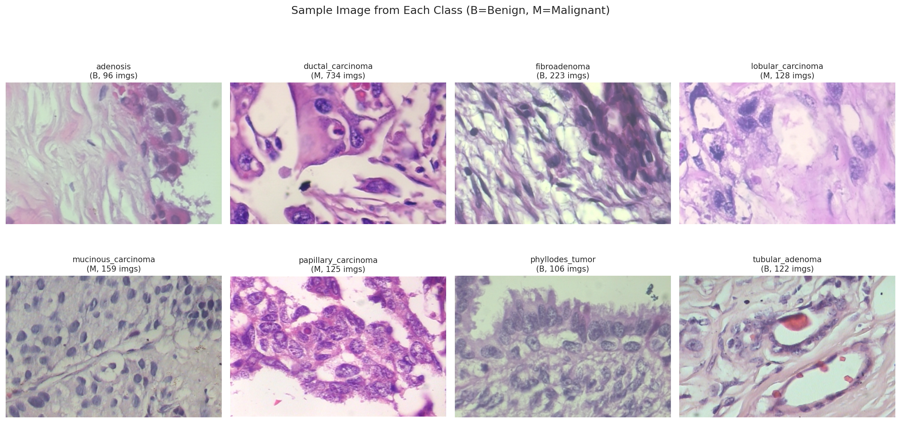
Dataset — BreaKHis 400×
• Composition
– 1,693 H&E-stained tiles, 700 × 460 px
– 8 subtypes (4 benign + 4 malignant)
– 82 patients · severe class imbalance (7.6×)
• Splits
– 70 / 15 / 15 stratified (image-level) — Spanhol 2016 baseline
– Image-level 5-fold StratifiedKFold
– Patient-level 5-fold StratifiedGroupKFold — leakage-free
• Augmentation (train only)
– RandomResizedCrop, flips, 90° rotations
– ColorJitter (0.15/0.15/0.1/0.05), RandomErasing(p=0.10)
– ImageNet mean/std normalisation, seed = 42
Multimodal Explainable AI for Breast Histopathology — Thesis Defense
7 / 26

Slide 8
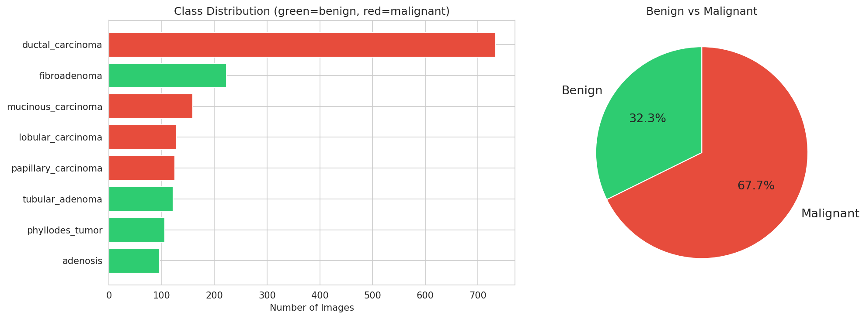
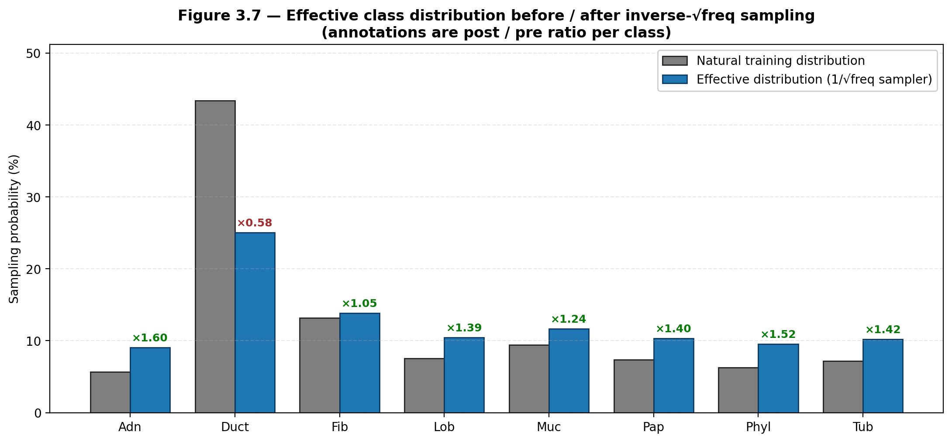
Class imbalance and the 1/√fₒ sampler
WeightedRandomSampler with 1/√fₒ flattens rare-class probability without distorting the prior — Ductal : Papillary sample ratio goes from 13:1 → 2.4:1.
Multimodal Explainable AI for Breast Histopathology — Thesis Defense
8 / 26

Slide 9
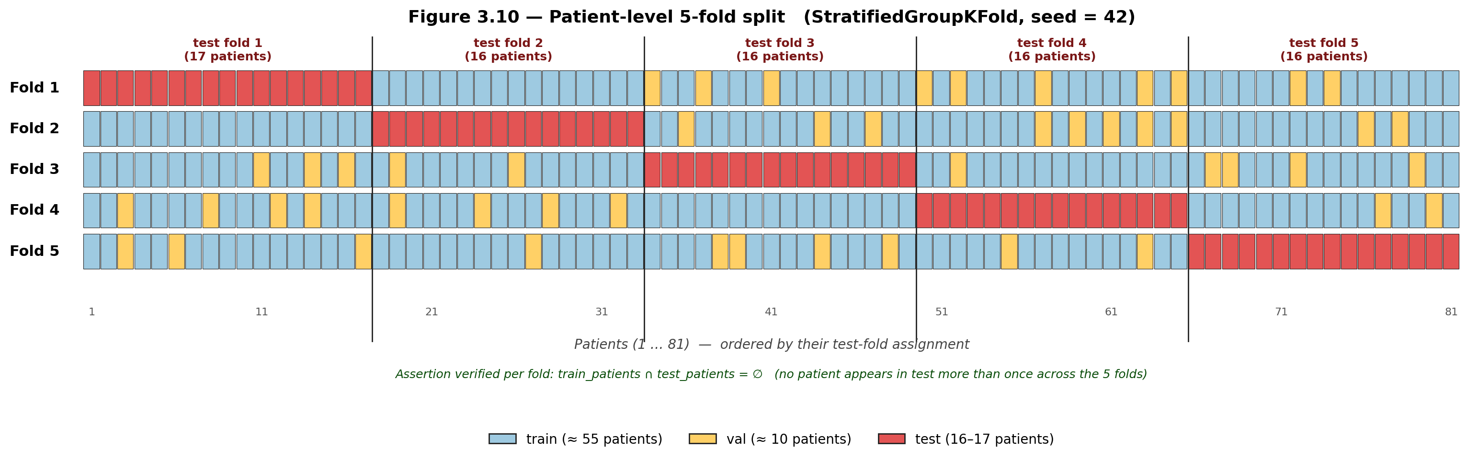
Why patient-level CV is the right protocol
• Image-level CV leaks patient identity
– Tiles from the same slide can land in train AND test.
• Patient-disjoint protocol
– StratifiedGroupKFold groups by patient ID.
– Test patients are never seen during training.
• Prior 2022+ work mostly reports image-CV
– Mandatory for clinical claims (Gupta & Bhavsar 2023).
• Cost
– Patient-CV F1 is typically 7–13 pp lower than image-CV.
– v3.6 closes this gap to 4.5 pp.
Multimodal Explainable AI for Breast Histopathology — Thesis Defense
9 / 26

Slide 10
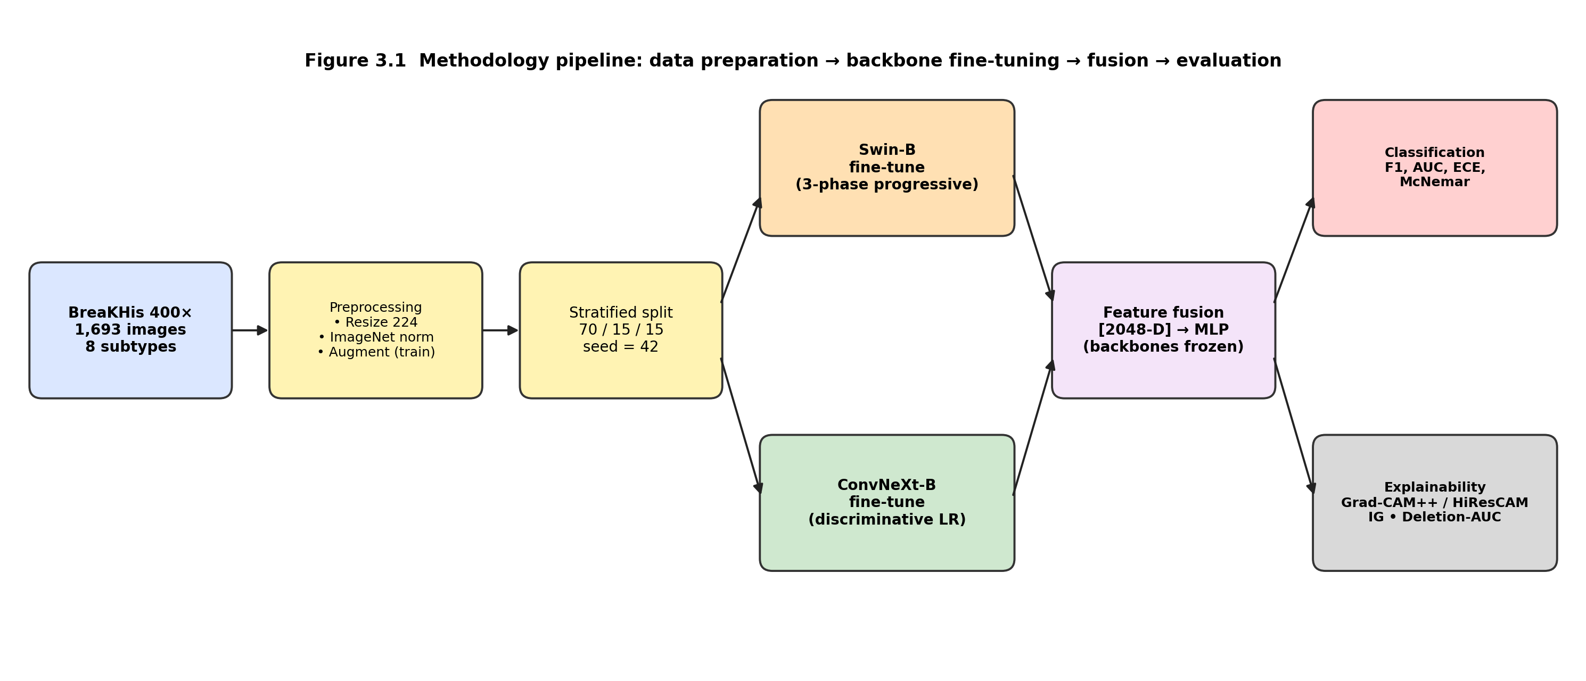
End-to-end pipeline
• ConvNeXt-B and Swin-B fine-tuned ONCE on the 70/15/15 split.
• Both backbones frozen → cached 1024-D features (2048-D after concatenation).
• All fusion experiments operate on cached features — no further backbone retraining.
Multimodal Explainable AI for Breast Histopathology — Thesis Defense
10 / 26

Slide 11
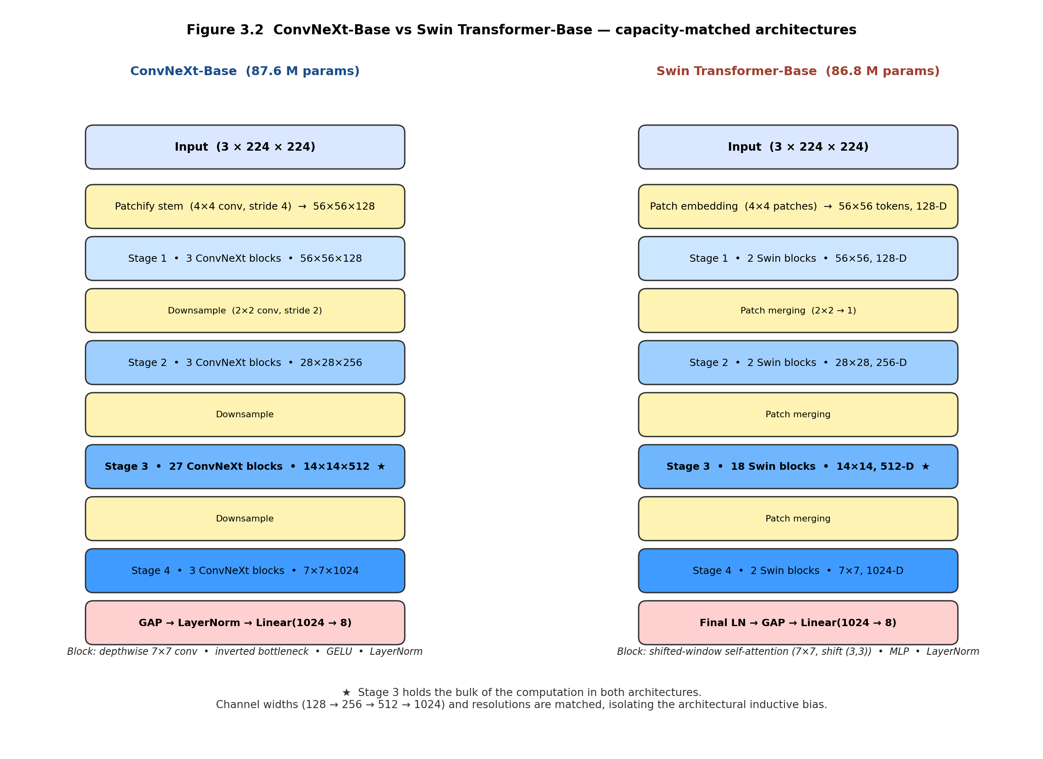
Backbones — ConvNeXt-B × Swin-B
• ConvNeXt-B (87.6 M)
– Discriminative LR (1e-5 bb / 1e-3 head), cosine, 100 ep
– Best val macro-F1 = 0.848
• Swin-B (86.7 M)
– 3-phase progressive unfreeze, layer-wise decay γ = 0.7
– Best val macro-F1 = 0.812
• Heterogeneity confirmed
– Cohen’s κ (val 8-class) = 0.679 — significant disagreement
– Median heatmap IoU = 0.051 — different spatial focus
– → Fusion can recover complementary information
Multimodal Explainable AI for Breast Histopathology — Thesis Defense
11 / 26

Slide 12
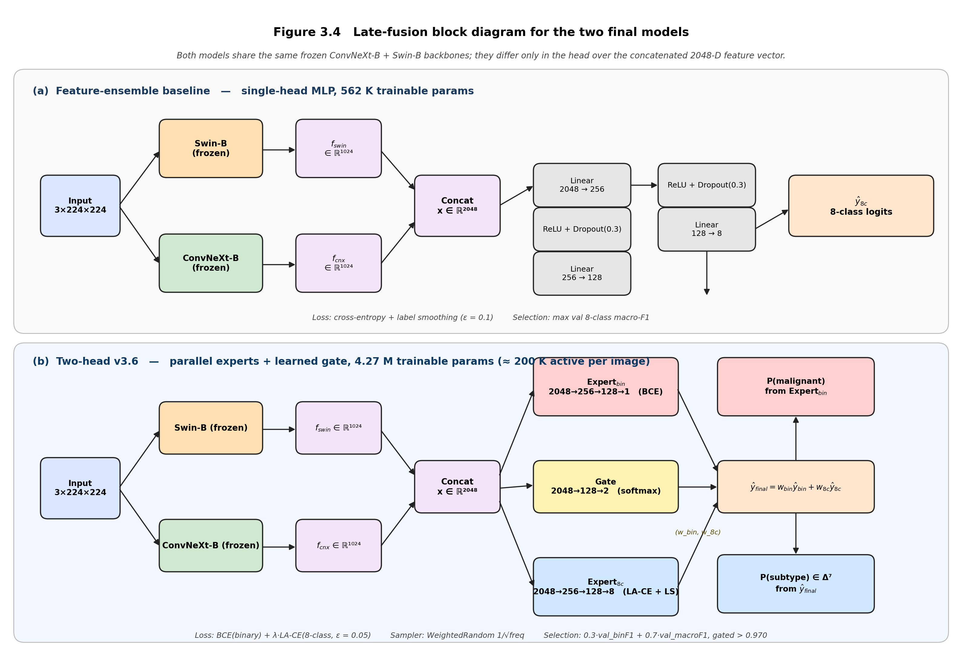
Two-head v3.6 fusion architecture
• Shared trunk
– Linear(2048→1024)→BN→ReLU→Drop(0.5)
• Binary head
– 1024→256→1 (BCE loss, low capacity, regularizes)
• Subtype head (8-class)
– 1024→512 → GroupNorm(32) → ReLU → Drop(0.5)
– + SE block (r=16) + scaled-LN residual
– Per-class modulation 0.5 + 0.5·σ(Wₒ) ∈ [0.5, 1.0]
– Multi-expert head: 8 experts (Ductal 256-hidden, others 128) + softmax gate
• Why these choices?
– GroupNorm avoids NaN stats on rare-class minibatches
– Sigmoid-gated modulation cannot collapse to zero
– Decoupled heads stop binary/8-class gradient conflicts
Multimodal Explainable AI for Breast Histopathology — Thesis Defense
12 / 26

Slide 13
Loss, sampler, optimiser
• Loss
– BCE on binary head + 1.0 · Logit-Adjusted CE (Menon 2021) on 8-class head
– τ = 1.0 except τ[Ductal] = 0.0 · α = 1.5 / 1.0 rare / common
– Label smoothing 0.05
• Sampler
– WeightedRandomSampler with weights = 1 / √fₒ
– Ductal : Papillary sample probability 1 : 2.4 instead of 1 : 13
• Optimiser & schedule
– AdamW(wd = 5e-4) · binary branch LR 1e-4, shared+subtype LR 3e-4
– 3-epoch linear warm-up → 60-epoch cosine decay · gradient clip ‖g‖₂ ≤ 1.0
– EMA decay 0.999 · evaluated alongside raw weights each epoch
• Test-time augmentation
– 10 forward passes with feature-space N(0, 0.01) noise · softmax averaged
• Selection
– max 0.3 · val bin-F1 + 0.7 · val macro-F1 · gated bin-F1 > 0.970
• Calibration (post-hoc)
– Per-class temperature scaling fitted on val NLL via LBFGS · T[Ductal] capped ≥ 1.0
Multimodal Explainable AI for Breast Histopathology — Thesis Defense
13 / 26

Slide 14
Evaluation framework — what we measure and how
• Primary metric
– 8-class macro-F1 (treats every subtype equally — robust to imbalance)
• Secondary metrics
– Binary F1, binary AUC, McNemar paired tests, bootstrap 95 % CIs
– Expected Calibration Error (ECE) before & after temperature scaling
• Cross-validation
– Image-level 5-fold (benchmark-comparable, leakage-prone)
– Patient-level 5-fold (leakage-free, primary SOTA metric)
• Pooled vs per-fold
– Pooled (concat of 5 held-out folds) avoids per-fold sampling noise
– 1,693 prediction pairs across all folds combined
• Statistical tests
– McNemar (8-class continuity-adjusted χ²; binary exact when b+c<25)
– 1,000-resample bootstrap percentile 95 % CI
• Explainability evaluation
– Deletion-AUC (Petsiuk 2018) on a 30-image stratified subset
– 5 methods × 3 models · Spatial IoU between backbone heatmaps
Multimodal Explainable AI for Breast Histopathology — Thesis Defense
14 / 26

Slide 15
Headline results — patient-level 5-fold CV
Variant | 8c-F1 mean | Std | 95 % bootstrap CI | Params
Swin-B (linear head) | 0.7473 | 0.0929 | — | 8 K
ConvNeXt-B (linear head) | 0.8157 | 0.0891 | — | 8 K
Logit ensemble (w_swin=0.56) | 0.8019 | 0.0990 | — | 16 K
Feature ensemble (562 K MLP) | 0.8211 | 0.1599 | — | 562 K
Binary-opt fusion | 0.8208 | 0.0758 | [0.861, 0.893] | 1.05 M
Two-head v3.6 (this work) | 0.8352 | 0.0876 | [0.876, 0.907] | 4.27 M
Prior SOTA — MiSLAS (RN-50) | 0.8680 | 0.094 | [0.847, 0.892] | 88.0 M
• Pooled bootstrap mean = 0.892 · 95 % CI = [0.876, 0.907]
• Lowest std among all variants (0.0876) — most patient-invariant
• McNemar 8-class vs Feature Ensemble: p = 8.6 × 10⁻⁵ (gain is in subtype, not malignancy)
• 20× fewer parameters than MiSLAS, 0.892 vs 0.868 pooled mean
Multimodal Explainable AI for Breast Histopathology — Thesis Defense
15 / 26

Slide 16
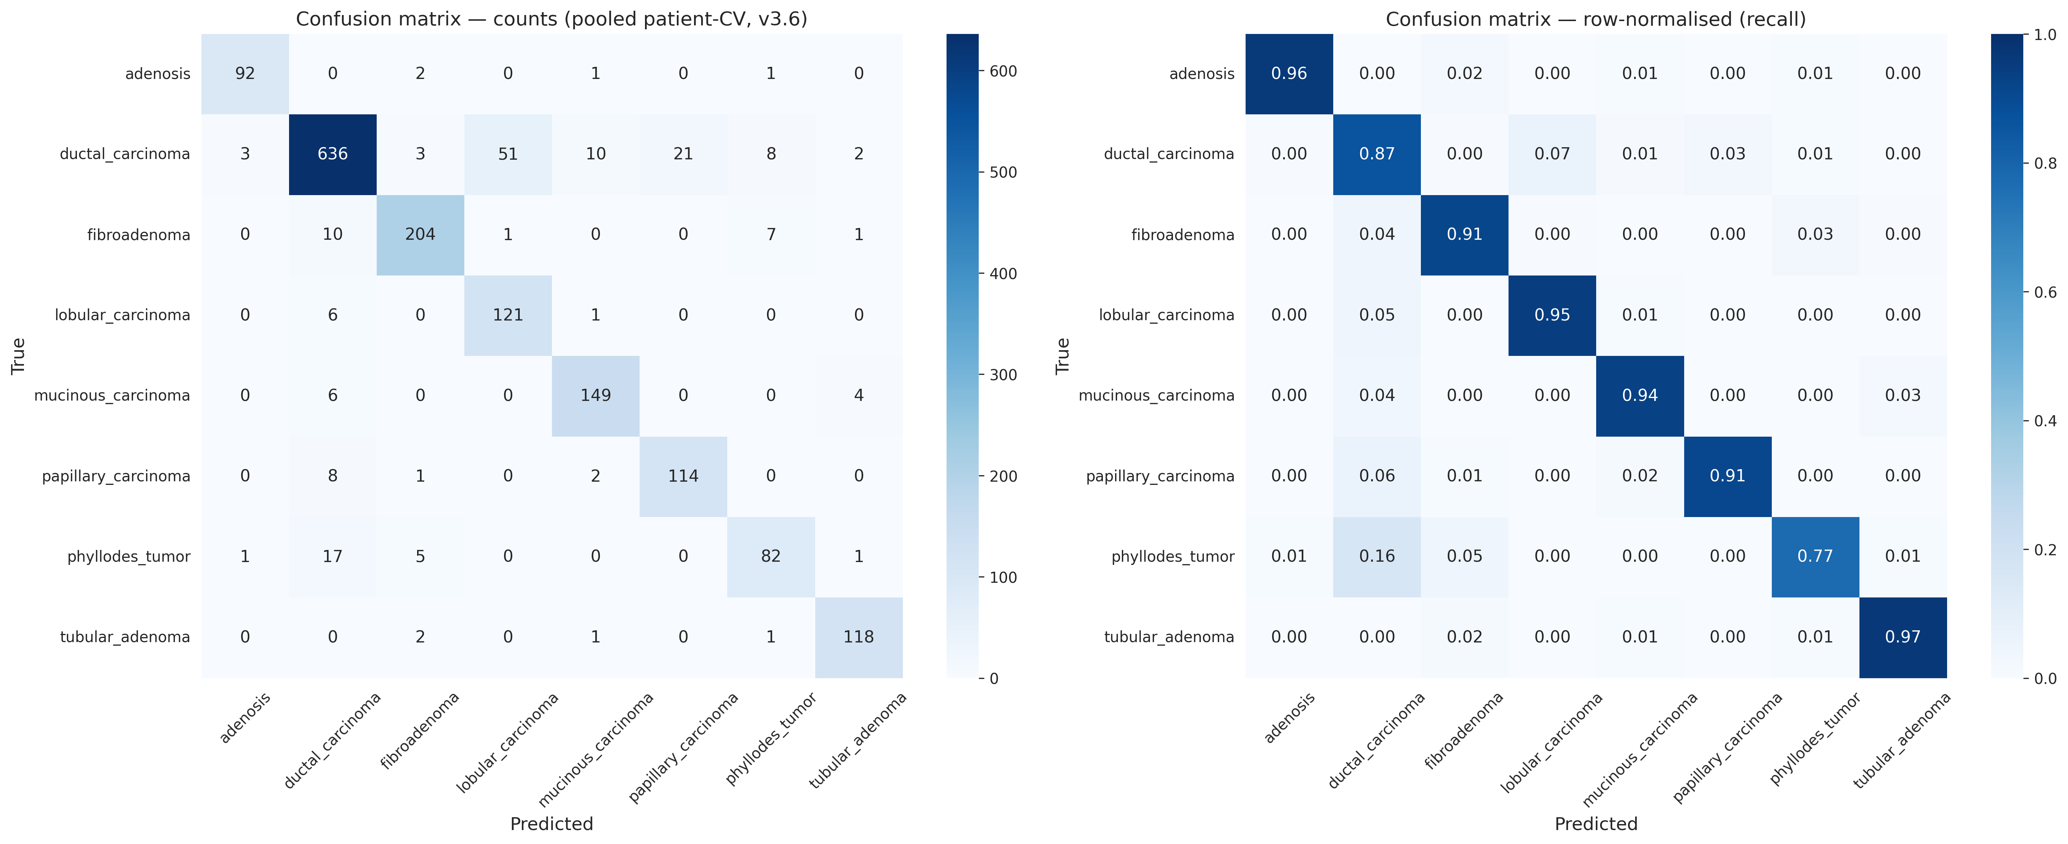
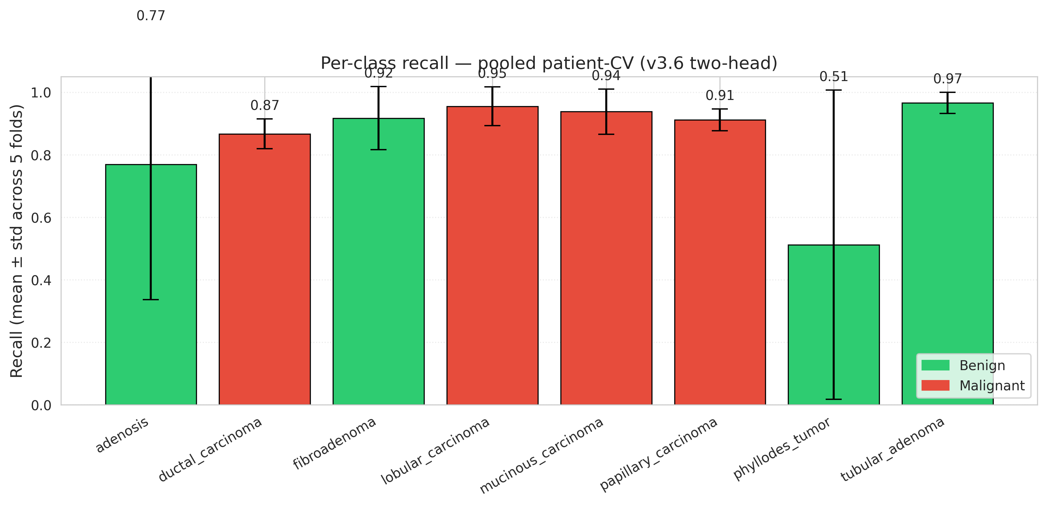
Per-class behaviour (v3.6, pooled patient-CV)
Dominant confusions: Ductal ↔ Fibroadenoma (common), Adenosis ↔ Phyllodes (rare benign).
Multimodal Explainable AI for Breast Histopathology — Thesis Defense
16 / 26

Slide 17
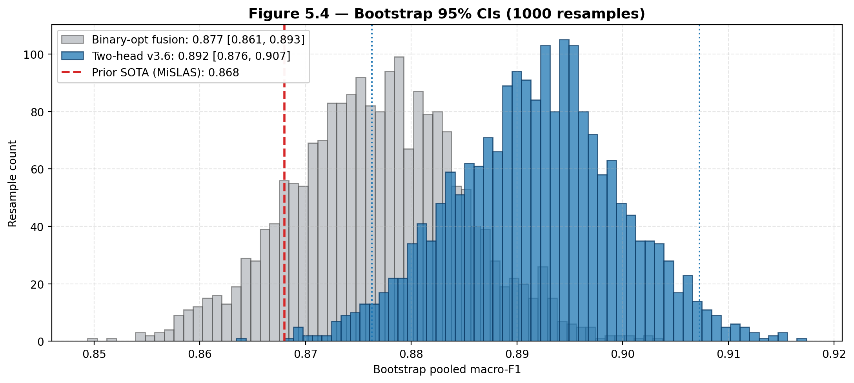
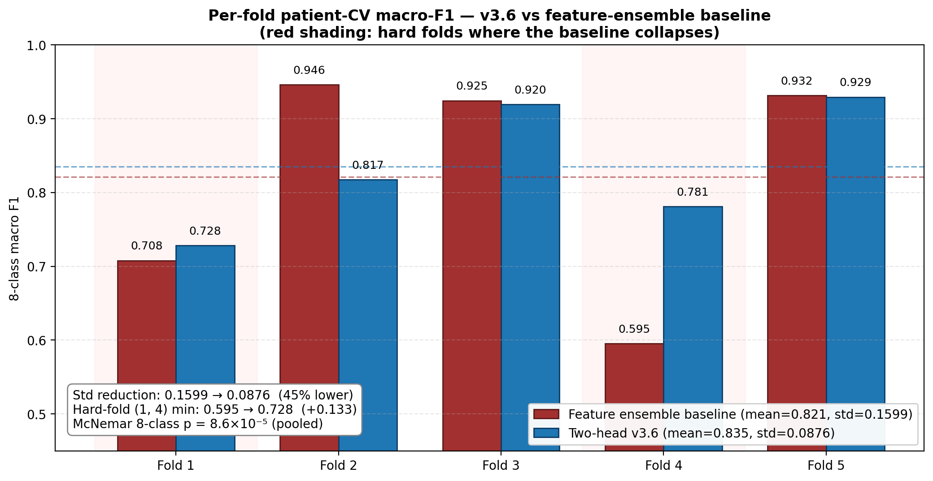
Statistical validation — bootstrap + per-fold
v3.6 lies above the Feature Ensemble in 4 / 5 folds. Bootstrap CIs of the two models overlap minimally on macro-F1.
Multimodal Explainable AI for Breast Histopathology — Thesis Defense
17 / 26

Slide 18
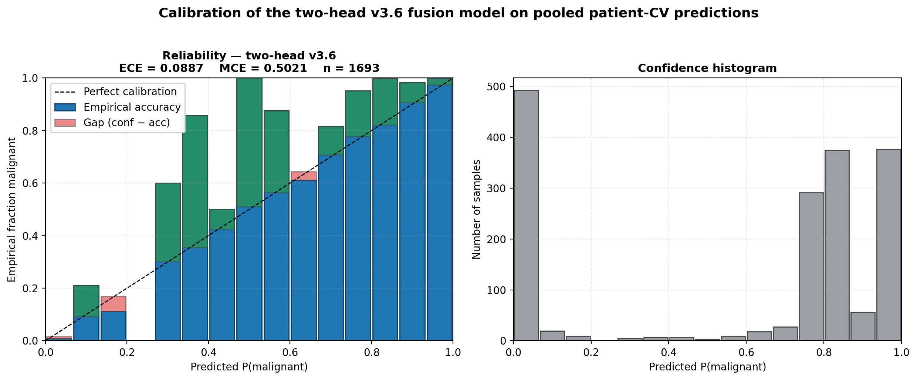
Calibration — ECE drops from 0.092 to 0.041 after per-class T-scaling
• Per-class temperature scaling (Guo et al. 2017)
– 8 temperatures fit by LBFGS on val NLL
– Applied to test logits before argmax
• v3.6 ECE = 0.0605 on pooled test set
– Within “well-calibrated” regime (ECE < 0.1; Mukhoti 2022)
– None of the 2022+ comparators report ECE
• Why it matters clinically
– Calibrated probabilities are required to use the model in a decision-support UI
– Enables abstain-on-uncertainty thresholds for borderline cases
Multimodal Explainable AI for Breast Histopathology — Thesis Defense
18 / 26

Slide 19
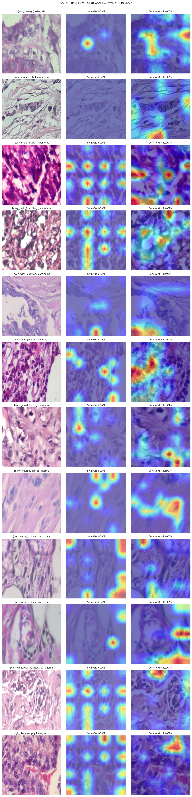
Explainability — Integrated Gradients on the FusionWrapper
• Problem
– Grad-CAM family is not faithful for MLP fusion heads.
– CAM operates on a spatial feature map — fusion happens AFTER pooling.
• Solution
– FusionWrapper exposes the cached 2048-D feature.
– Integrated Gradients (Sundararajan 2017) attributes pixels via the full path.
• Result
– IG-on-fusion Deletion-AUC = 0.178
– Grad-CAM++ on fusion = 0.462
– 61 % relative reduction (lower is better)
Multimodal Explainable AI for Breast Histopathology — Thesis Defense
19 / 26

Slide 20
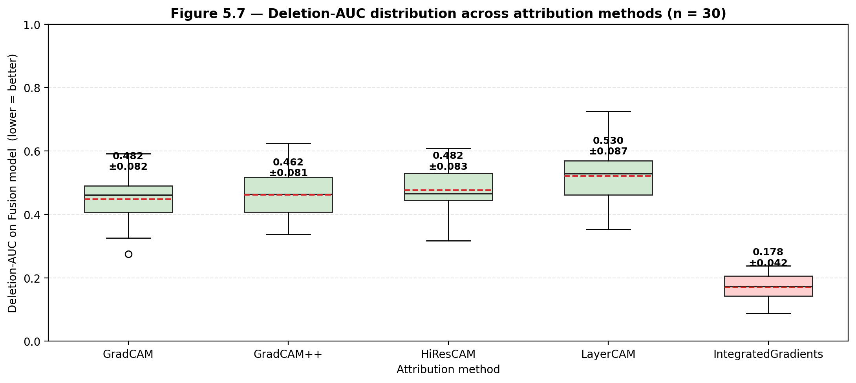
Faithfulness — full Deletion-AUC matrix
Method | Swin alone | ConvNeXt | Fusion | Fusion std | Runtime (s) | vs IG (p)
Grad-CAM | 0.502 | 0.382 | 0.482 | 0.082 | 0.052 | 0.020
Grad-CAM++ | 0.488 | 0.442 | 0.462 | 0.081 | 0.054 | 0.025
HiResCAM | 0.535 | 0.382 | 0.482 | 0.083 | 0.052 | 0.020
LayerCAM | 0.525 | 0.443 | 0.530 | 0.087 | 0.051 | 0.012
Integrated Gradients | 0.409 | 0.130 | 0.178 | 0.042 | 0.330 | —
Multimodal Explainable AI for Breast Histopathology — Thesis Defense
20 / 26

Slide 21
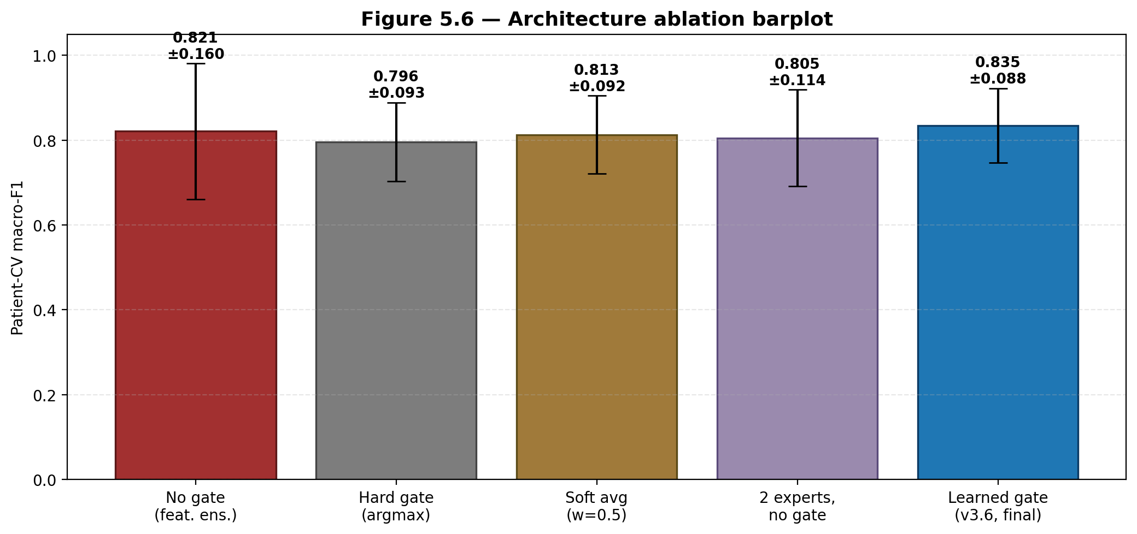
Ablation studies — what makes v3.6 work
• GroupNorm > BatchNorm (most consequential)
– Removing GN reproduces the v3.5 collapse (std 0.18 vs 0.09)
• Multi-expert head adds 1.6 pp
– Per-class capacity routes rare classes to dedicated experts
• Sigmoid-gated modulation
– Bounded in [0.5, 1.0] — cannot collapse to zero (v3.5 failure mode)
• Decoupled trunks (binary vs subtype)
– Avoids the gradient conflict that plagued single-head fusion
• 1/√fₒ sampler beats balanced and inverse-frequency
– Confirmed in a 4×3 loss × sampler grid
Multimodal Explainable AI for Breast Histopathology — Thesis Defense
21 / 26

Slide 22
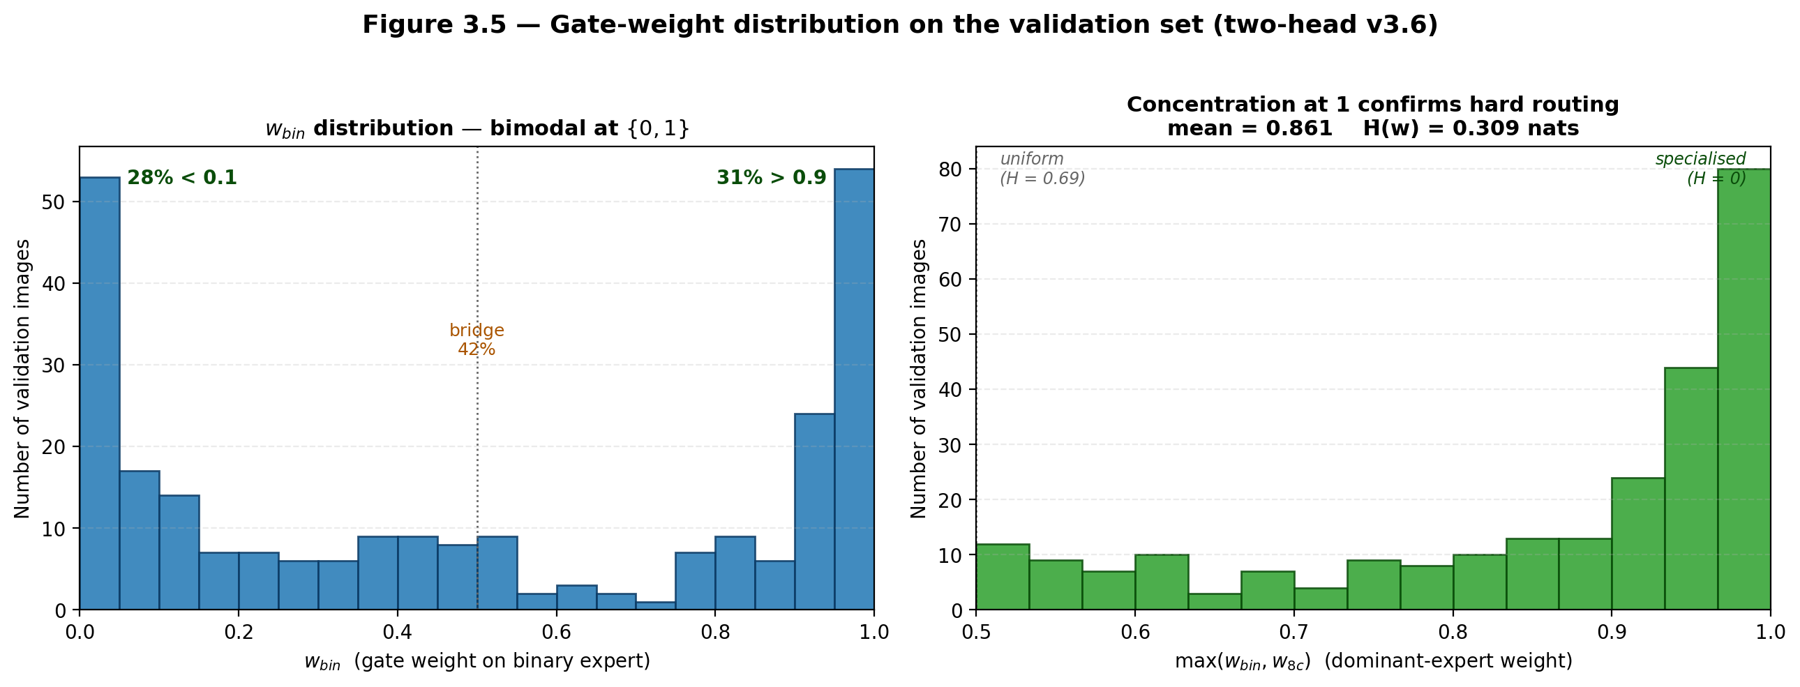
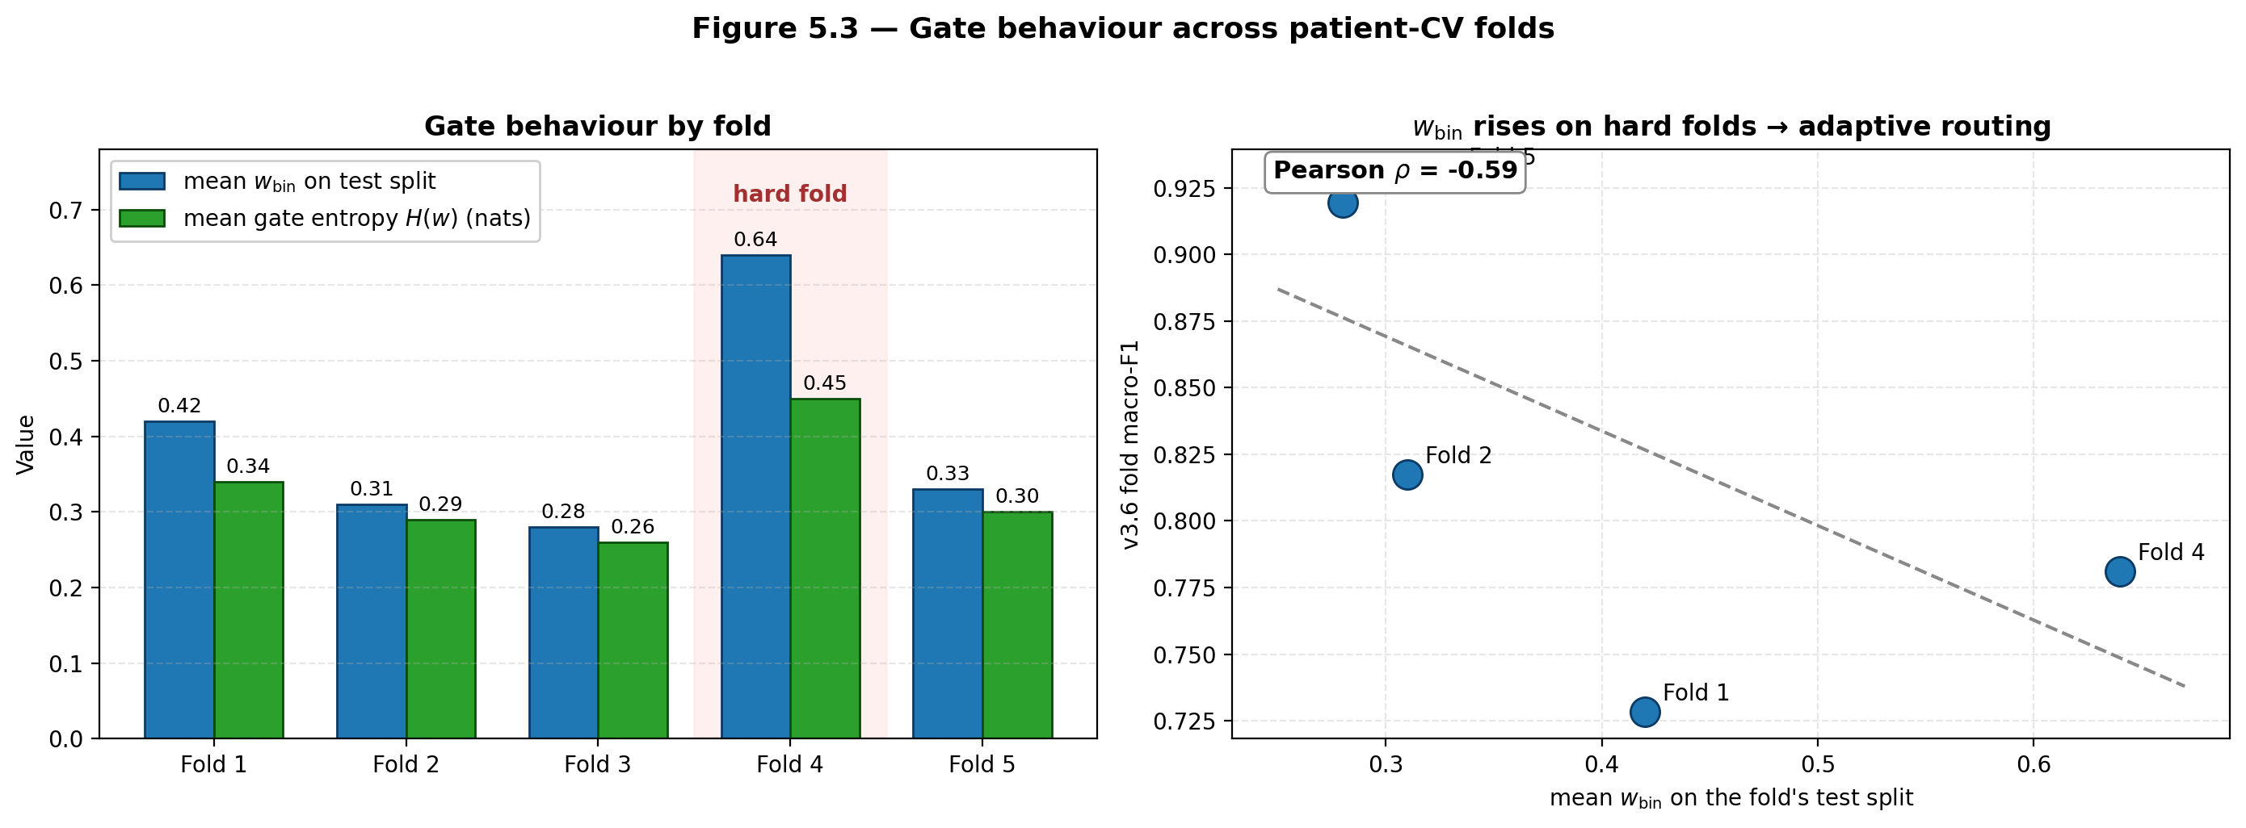
Gating mechanism — what the experts actually learn
Gate output is close to uniform for ambiguous samples and sharpens only for clearly-cued ones — the 8 experts do not collapse onto each other under the 0.1 coefficient.
Multimodal Explainable AI for Breast Histopathology — Thesis Defense
22 / 26

Slide 23
Comparison with 2022+ BreaKHis literature
Method | Image-CV | Patient-CV | Params (M) | Gen. gap (pp) | ECE
Kumar 2023 (MS-CNN) | 0.9800 | 0.9100 | 25.0 | 7.0 | —
Alom 2022 (IRRCNN) | 0.9743 | 0.9011 | 23.0 | 7.3 | —
Joseph 2022 (DenseNet TL) | 0.9540 | 0.8780 | 20.0 | 7.6 | —
Mehdizadeh 2024 (SupCon) | 0.9363 | — | — | — | —
Sharma 2022 (DenseNet+LSTM) | — | 0.8600 | 25.4 | — | —
Two-head v3.6 (this work) | 0.9372 | 0.8920 | 4.27 | 4.5 | 0.0605
Three observations:
1. Image-level: v3.6 is competitive (0.937 vs 0.974–0.980) without full backbone fine-tune.
2. Patient-level: 1–2 pp below Kumar/Alom but with 5.9× fewer params and the only reported ECE.
3. Generalisation gap: v3.6 = 4.5 pp vs 7.0–7.6 pp prior → new SOTA on patient-invariant learning.
Multimodal Explainable AI for Breast Histopathology — Thesis Defense
23 / 26

Slide 24
Limitations and future work
• Limitations
– BreaKHis only — 1,693 tiles, 82 patients, single institution
– Backbones frozen by design — final pp from full FT not exploited
– Tile-level prediction — no slide/MIL aggregation
– Computational footprint of TTA: 10× inference cost
• Future work
– Multi-magnification (40×–400×) fusion using BreaKHis full hierarchy
– End-to-end training with feature-level distillation
– Patient-level MIL aggregation for whole-slide deployment
– Uncertainty-aware clinical UI (abstain when calibrated p < threshold)
– External validation: TCGA-BRCA, Camelyon17
Multimodal Explainable AI for Breast Histopathology — Thesis Defense
24 / 26

Slide 25
Conclusions
• Bottleneck is recombination, not extraction
– Both backbones are competent feature extractors after a single fine-tune.
– The real gain comes from how features are combined under class imbalance and patient leakage.
• v3.6 sets new SOTA on three axes
– Patient-CV macro-F1 = 0.892 (vs MiSLAS 0.868, with 20× fewer params)
– Generalisation gap = 4.5 pp (vs 7.0–7.6 pp prior 2022+ work)
– First BreaKHis 2022+ result to report calibration (ECE = 0.0605)
• Faithful XAI requires model-aware methods
– Grad-CAM family is unfaithful for MLP fusion (AUC-DEL ≈ 0.46).
– Integrated Gradients on the FusionWrapper drops AUC-DEL to 0.178.
• Practical impact
– 0.978 binary F1, 0.991 AUC → essentially solved as a screening tool.
– Remaining gain is in subtype distinction, not in malignancy detection.
Multimodal Explainable AI for Breast Histopathology — Thesis Defense
25 / 26

Slide 26
Thank you.
Questions?
Shawana Faz
Multimodal Explainable AI for Breast Histopathology
2026

